Slide 1

Enhanced Stock Return Prediction Using Machine Learning and Large Language Model Based Feature Extraction
By: Austin N. Thompson
Notes:
Image created via Chat GPT

Slide 2
Overview:
Problem: Monte Carlo simulations rely only on historical price metrics, ignoring contextual factors (earnings, news sentiment, analyst opinions), leading to oversimplified risk predictions.
Goal: Integrate structured (price/volume) and unstructured (news/sentiment) data using APIs and LLMs for context-aware stock return predictions.
Case Study: Predict 1-week performance for TSLA and AAPL using 1 year of data.
Limitations: Noisy stock data requires advanced ML techniques (momentum features, bootstrapping, stacking).

Slide 3
Application Programming Interface (APIs):
yFinance (Free): Yahoo Finance data (stock prices, historical data, company info).
NewsAPI (Rate-limited, paid for full access): Fetches news by keywords, sources, categories.
GDELT API (Free): Tracks global news events and trends in real-time.
OpenAI API (Paid, ~$2 for this project): GPT-4 for text generation and feature extraction.
Other Options: Alpha Vantage, IEX Cloud, Barchart, Finnhub (paid, not used).

Slide 4
Methodology:
Data Collection: Historical price/volume data (1-week intervals) via yFinance.
Feature Extraction: Momentum features (rolling averages, RSI, MACD).
RAG Database:
NewsAPI/GDELT for news articles.
Store in CSV, convert to FAISS index for LLM.
LLM Feature Extraction: GPT-4 with prompt engineering.
Data Integration: Merge qualitative (sentiment, risk) and quantitative features.
Feature Engineering: VADER sentiment analysis, sentiment/risk mapping.
Model Training: Stacking model (Gradient Boosting, Linear Regression, Elastic Net).
Prediction: Next week's log return and volatility.
Monte Carlo: Run simulations and plot results.

Slide 5
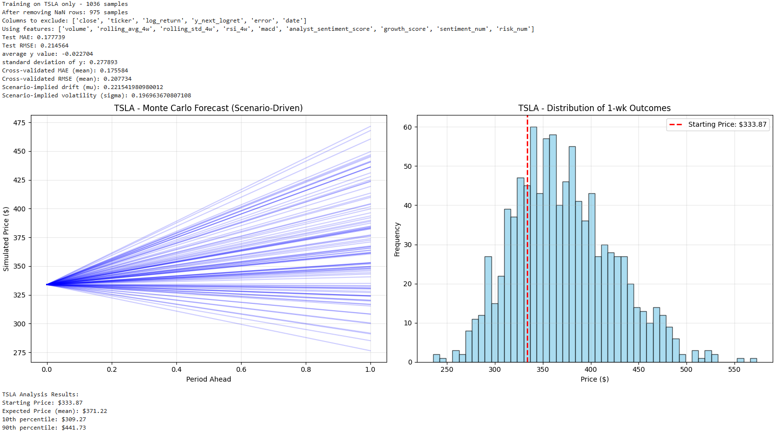

Slide 6
Summary:
Application Programming Interfaces (APIs) are more useful than just data collection. They can also be used for querying Large Language Models (LLMs).
Retrieval Augmented Generation (RAG) (via FIASS index and LLMs) is a powerful tool that can be used to sort though a large CORPUS of contextual data.
Preparing data for RAG through a LLM is a multi-step process that involves embedding contextual data and building a FIASS index
LLMs require good prompt engineering to be able to extract relevant information from contextual data sources.
Stock Data is extremely noisy. Must use advanced Data Science / ML techniques such as bootstrapping, hyperparameter tuning, and stacking to get accurate model.

Slide 7

Backup

Slide 8
Process:
Obtain Historical Price and Volume Data (1 – week interval)
Feature Extraction: Volume, rolling averages, Relative Strength Index (RSI), Moving Average Convergence Divergence (MACD)
Derived from pricing and volume data obtain using yFinance API
Creation of Retrieval Augmented Generated (RAG) Database
NewsAPI and GDELT API to obtain news articles for associated tickers at 1-week intervals
Store textual data in a CSV file
Convert textual data into a FAISS Index (this is what LLM / RAG needs to operate)
FAISS (Facebook AI Similar Search) used to build an efficient vector search systems to support providing “context” before generating responses from an LLM

Slide 9
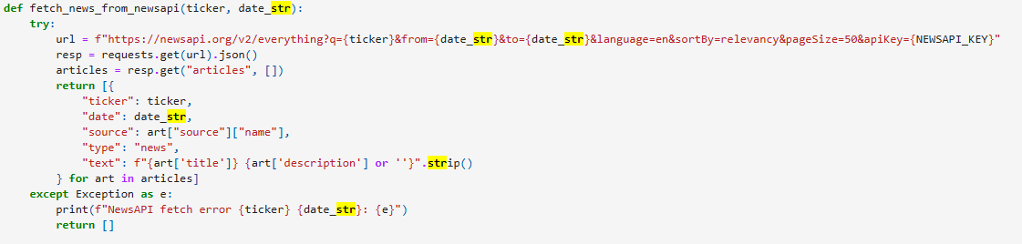
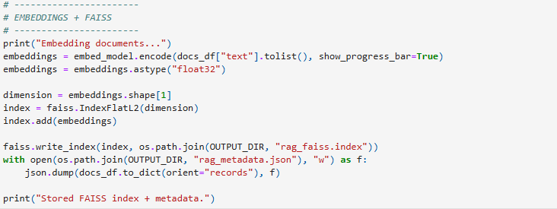
RAG Development Code:
A Sentence Transformer is a type of model that converts entire sentences or paragraphs into fixed-size dense vectors (also called embeddings).
These embeddings capture the semantic meaning of the text — so sentences with similar meanings get vectors close to each other in vector space.

Slide 10
Process Continued (2):
Feature Extraction using LLM (“gpt-4”):
OpenAI API (costs money)
Other Alternative: Download OLLAMA and use a “small” LLM on your personal computer.
OLLAMA: (https://ollama.com/)
Need more powerful computer to do this (aka GPU, higher ram, and processing power)
Limited to small models unless you have storage and computational capacity/capability to run very large LLMs
Provide the LLM Context via the FAISS Index
Queary the LLM
prompt engineering is very important
Must tells LLM what you want, what to analyze, and how to output data
Build data frame with LLM Queary Outputs

Slide 11
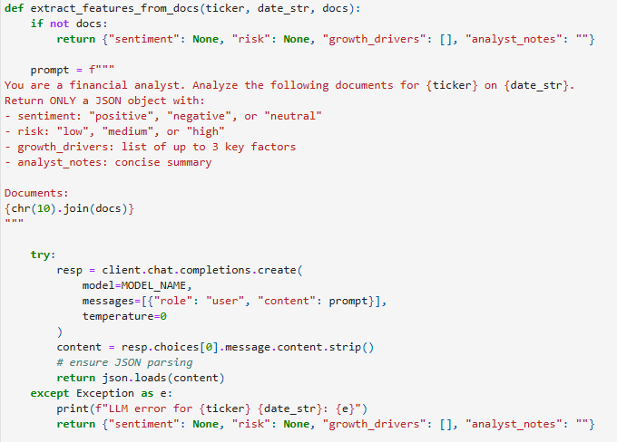
LLM Query Code:

Slide 12
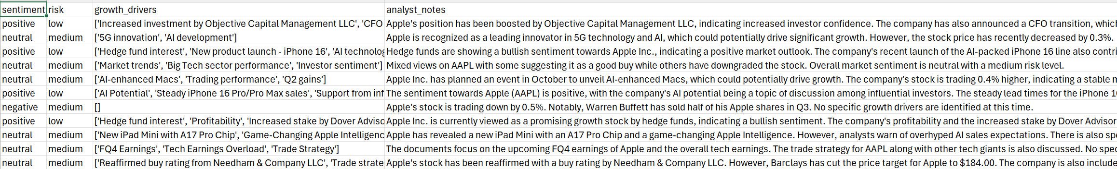
LLM Outputs:

Slide 13
Process Continued (3):
Merge Qualitative Features and Historical Pricing Data
Pricing Data: Volume, rolling averages, Relative Strength Index (RSI), Moving Average Convergence Divergence (MACD)
Qualitative Data:
sentiment: "positive", "negative", or "neutral"
risk: "low", "medium", or "high"
growth drivers: list of up to 3 key factors
analyst notes: concise summary
Final Feature Engineering and Dataset Preparation:
Qualitative Features Data Extraction:
Polarity Scores to convert growth drivers and analyst notes into numeric values
sentiment_map = {"negative": -1, "neutral": 0, "positive": 1}
risk_map = {"low": 0, "medium": 1, "high": 2}

Slide 14
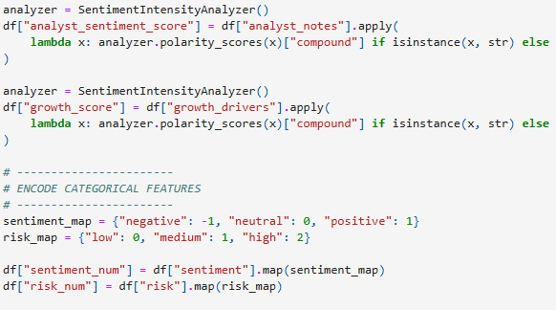
Final Feature Extraction Code:
Polarity via Vader Sentiment Analysis: VADER (Valence Aware Dictionary and sEntiment Reasoner) is a lexicon and rule-based sentiment analysis tool. Especially tuned for social media texts but works well on other English text. Provides compound, positive, neutral, and negative scores.

Slide 15
Process Continued (4):
Train ML Model:
Define X and Y
Y: next_log_return (derived from closing pricing data from yFinance)
Stacking Model:
Estimators:
Gradient boosting
Linear Regression
Elastic Net
Final Estimator: Linear Regression
Make Prediction:
Next_log_return (drift)
Sigma (implied volatility):
Standard deviation (predicted vs actual) of the 10% closest historical data points to the scenario

Slide 16
Process Continued (5):
Run Monte Carlo and Plot Results:
Current Stock Price
Implied Drift (obtained from ML Model)
Implied Volatility (sigma obtained from ML Model)
Execute a Scenario:
SCENARIO = {
'volume': 200000000, # example value, update as needed
'rolling_avg_4w': 230, # example value, update as needed
'rolling_std_4w': 5, # example value, update as needed
'rsi_4w': 50, # example value, update as needed
'macd': 0.5,
'analyst_sentiment_score': 1, # (Range: -1 to +1) -1 = Very negative, 0 = Neutral, +1 = Very positive
'growth_score': 1, # (Range: -1 to +1) -1 = Negative growth prospects, 0 = Neutral, +1 = Strong growth drivers
'sentiment_num': 1, # (Values: -1, 0, 1) -1 = "negative", 0 = "neutral", 1 = "positive"
'risk_num': 2, # (Values: 0, 1, 2) 0 = "low" risk, 1 = "medium" risk, 2 = "high" risk
}
Overcoming Noisy Stock Data:
Bootstrapping
More Features (4-week, 2-week, and 1-week momentum drivers)
More Data
Hyperparameter Tuning

